Slide 1

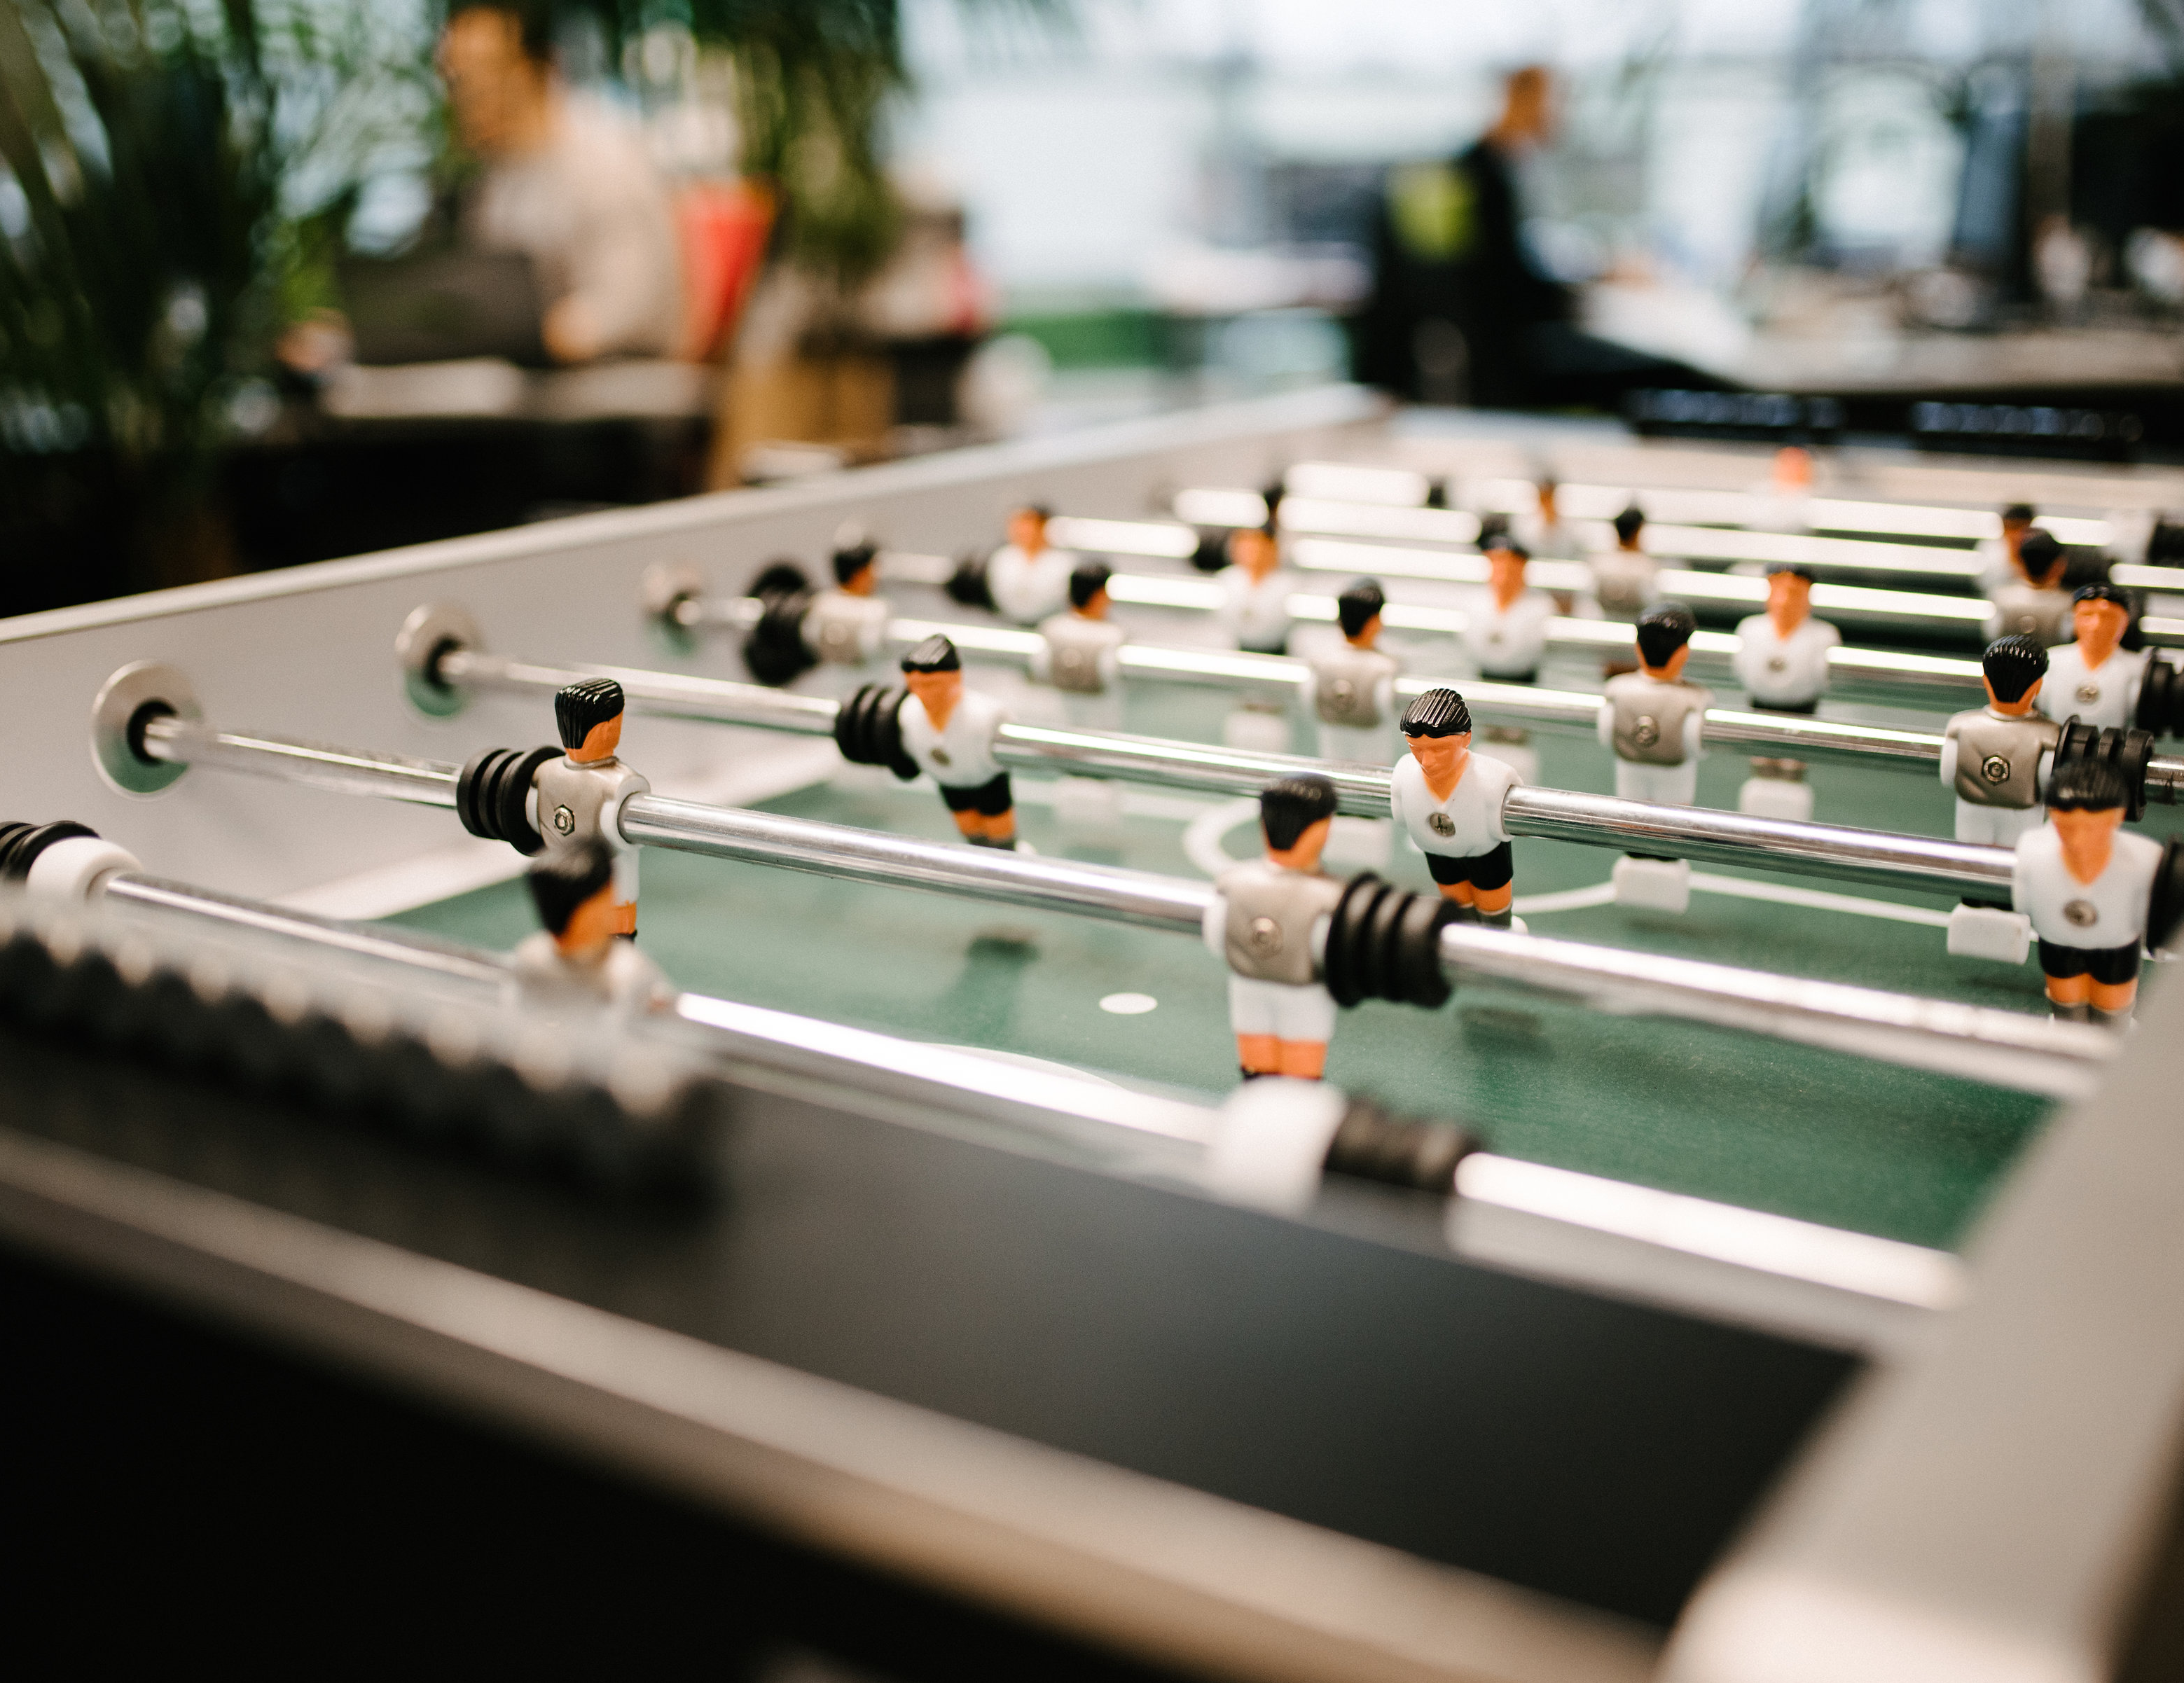
Nedap University
Module 1 assignment

Slide 2
Table of contents
Game assignment
Explanation assigment
Assessment criteria
Protocol
Resources
Important dates
Contact information

Slide 3
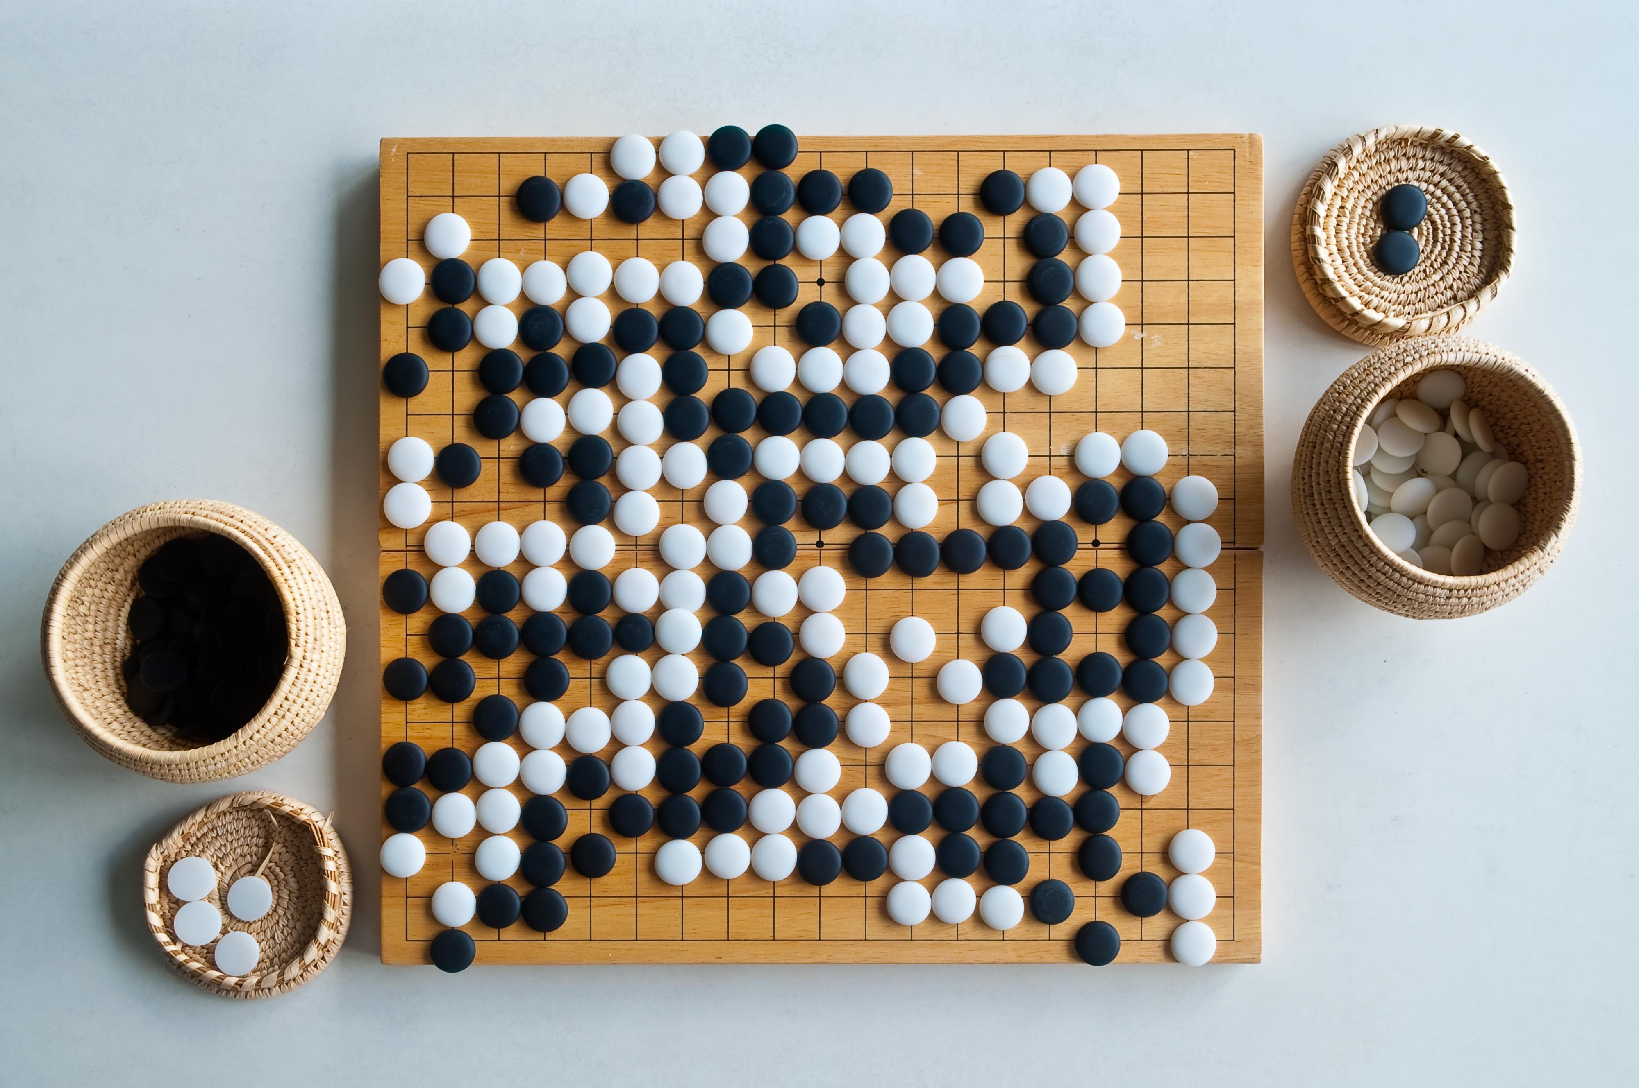
Game explanation

Slide 4
Game explanation
Go is an abstract strategy board game for two players in which the aim is to surround more territory than the opponent.
https://www.youtube.com/watch?v=5PTXdR8hLlQ

Slide 5
Game explanation
The board of configurable square size is empty at the start of the game.
Black makes the first move, after which white and black alternate.
A move consists of placing one stone of a player their own color on an empty intersection on the board.
A player may pass their turn at any time.
A stone or solidly connected group of stones of one color is captured and removed from the board when all the intersections directly orthogonally adjacent to it are occupied by the opponent.
Self-capture/suicide is allowed (this is different from the commonly used rules).
When a suicide move results in capturing a group, the group is removed from the board first and the suiciding stone stays alive.
No stone may be played so as to recreate any previous board position (ko rule https://en.wikipedia.org/wiki/Rules_of_go#Repetition).
Two consecutive passes will end the game.
A player's area consists of all the intersections the player has either occupied or surrounded.
The player with the biggest area wins. This way of scoring is called Area Scoring https://en.wikipedia.org/wiki/Rules_of_go#Area_scoring. In case of an equal score, there is a draw.
Notes:
Een steen of stevig verbonden groep stenen van één kleur wordt gevangen en van het bord verwijderd wanneer alle kruispunten die er loodrecht aan grenzen, bezet zijn door de tegenstander.

Slide 6
Explanation assignment
Two applications
A server application that can host games
A client application that connects with the server and allows a player to participate in a game
Two interface types
Textual user interfaces (TUIs) for both server and client
A graphical user interface (GUI) for the client for displaying the current state
Enforcement of the game rules
Support for playing the game over the network
Support for 2 players per game
Support for computer players (AI)

Slide 7
Deliverables assignment
Application
Report
Tournament

Slide 8
Assessment criteria
Code quality
Tests
Documentation
GitHub

Slide 9
Protocol
The game should run player vs player, this requires a protocol between clients
It’s important to start early with this protocol!
Base implementation should be ready end of next Monday
Communicate protocol updates!

Slide 10
Resources
Base project
https://github.com/nedap/university-goGame
Go rules
https://en.wikipedia.org/wiki/Rules_of_Go#Basic_rules
Protocol updates
Decide on how communicate and negotiate changes within the protocol

Slide 11
Important dates
13th of January – Kick-off assignment
16th of January – Finalize base protocol
2nd of February 23:59 – Submit assignment and prepare for tournament
3rd February – Assignment evaluation
Presentations
Individual evaluation
Tournament

Slide 12
Contact information
Game specific questions
Stijn Wopereis – Teams/Slack
Programming questions
Coach

Slide 13
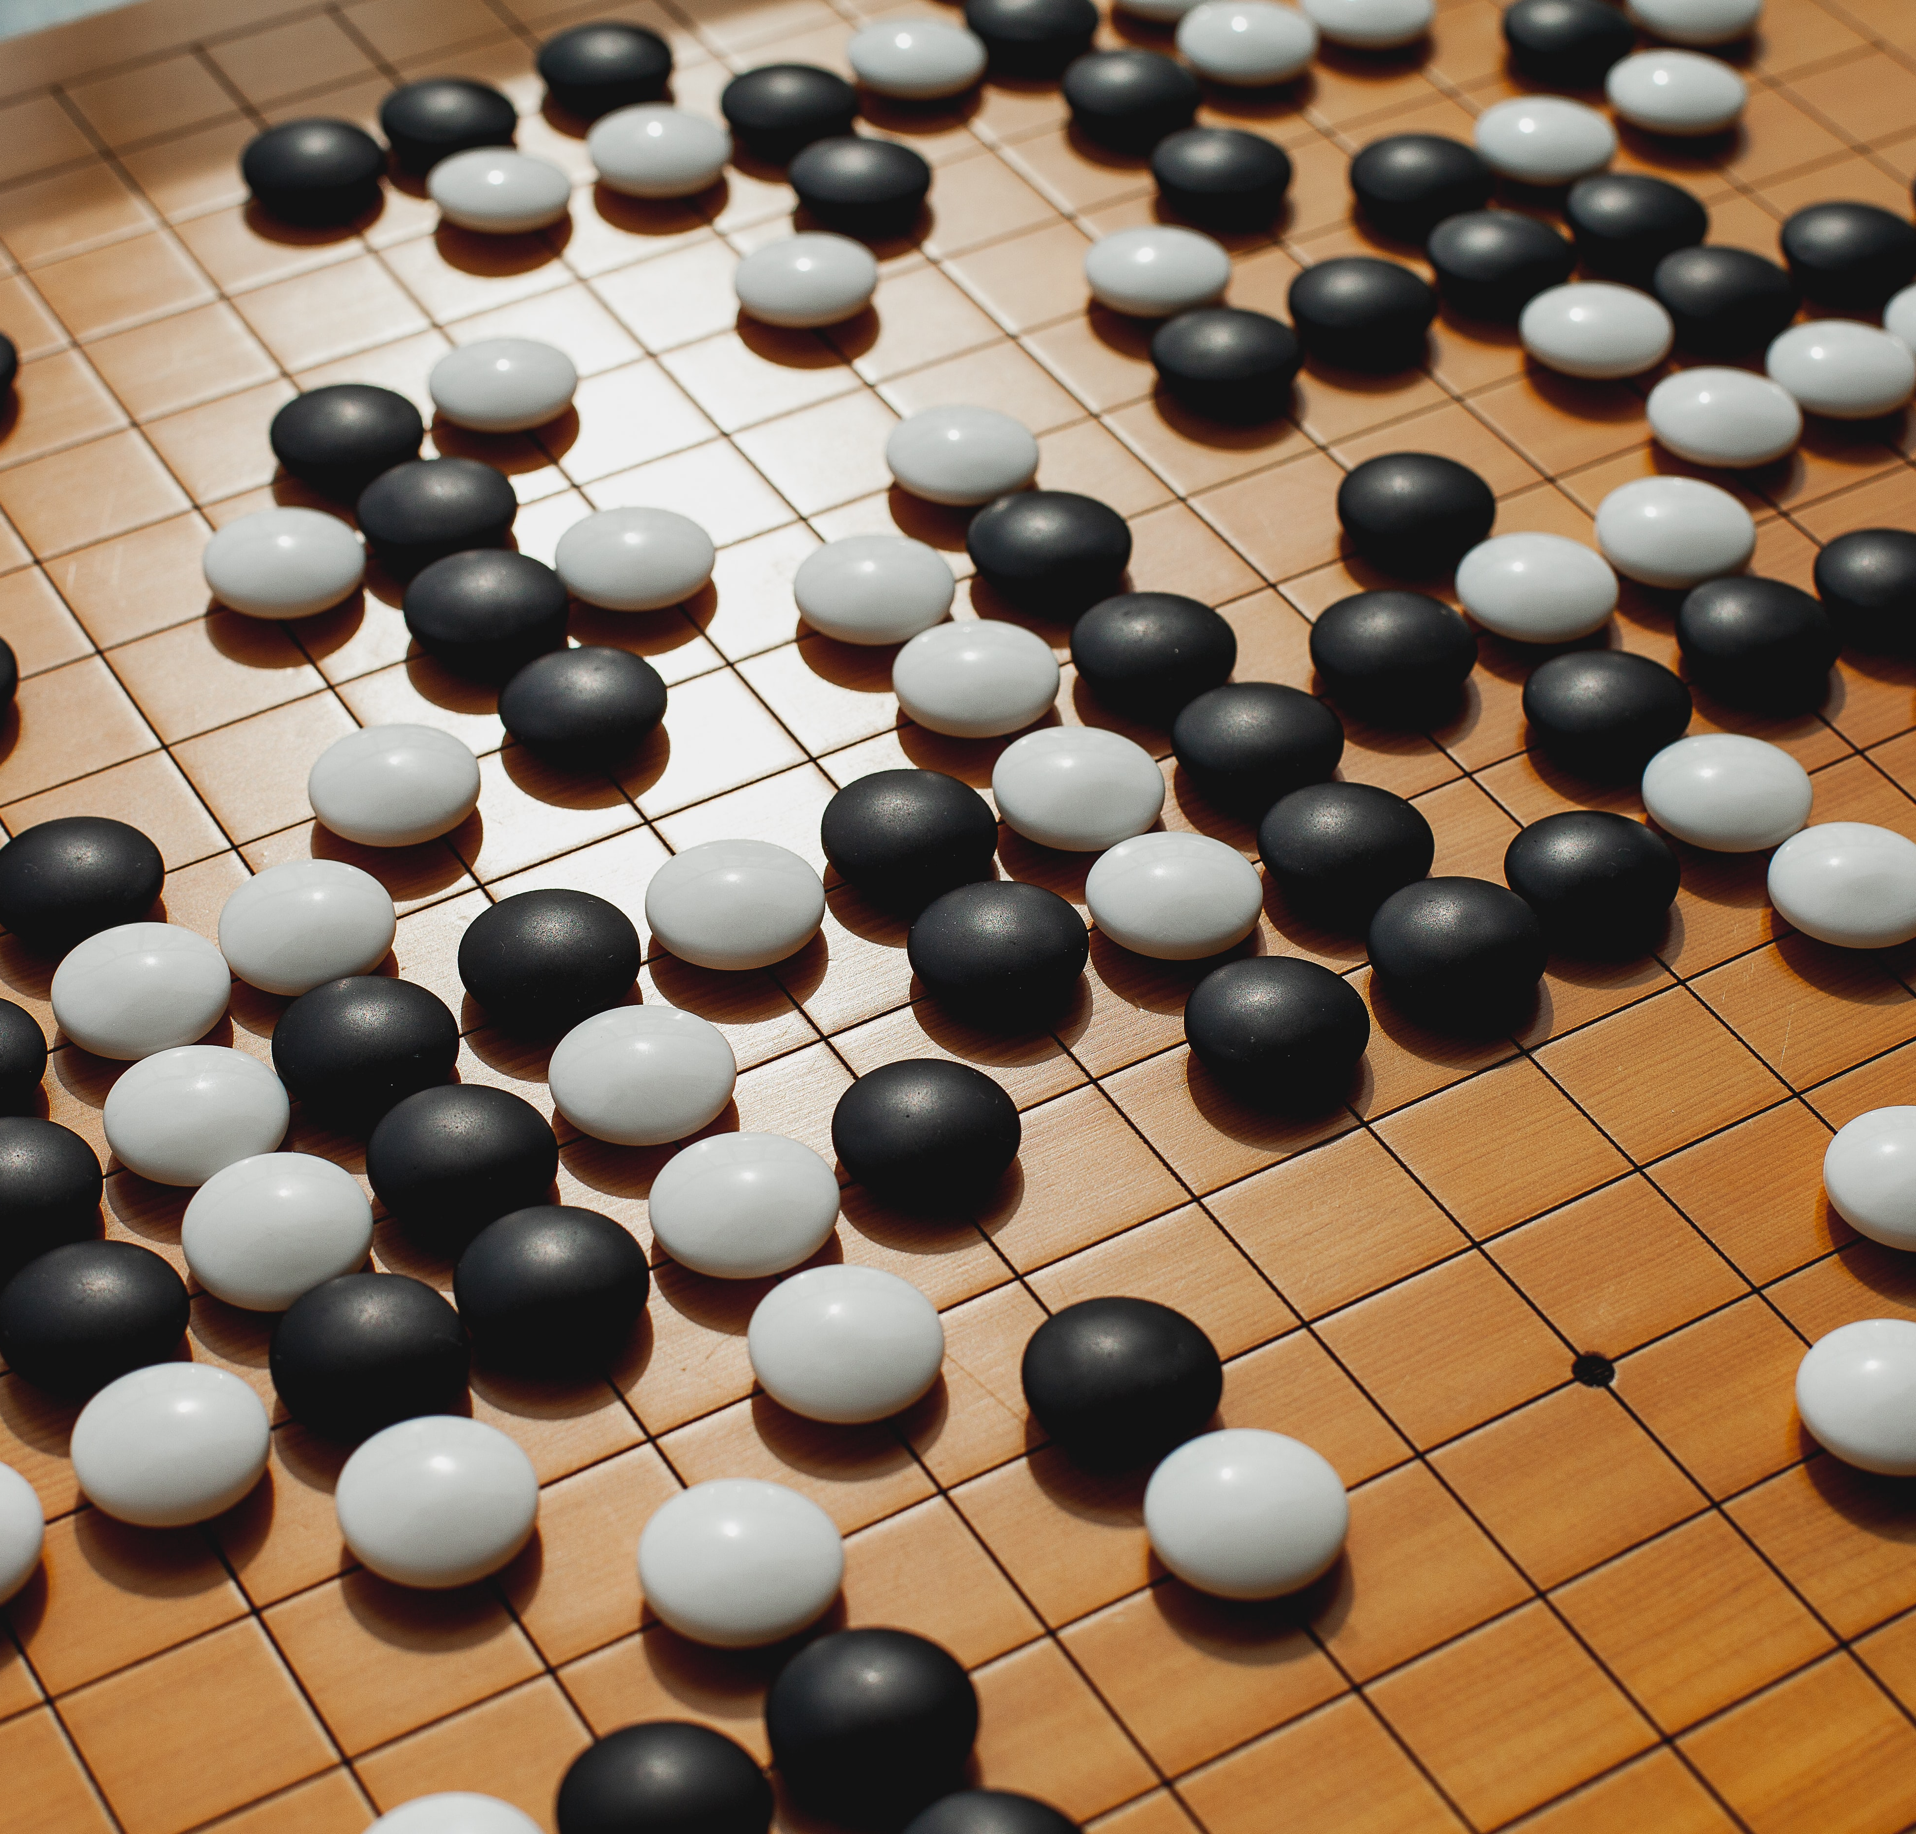
Let’s GO!

